Slide 1
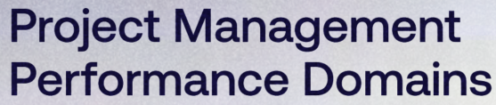
Dr. Farrukh Zeshan

Slide 2
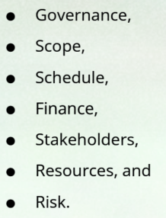
Project Management Performance Domains

Slide 3
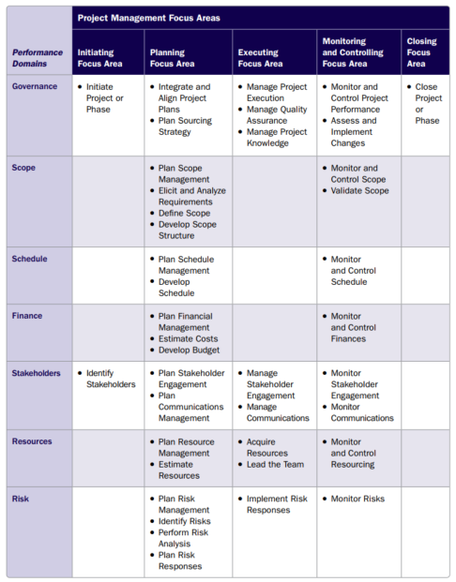

Slide 4
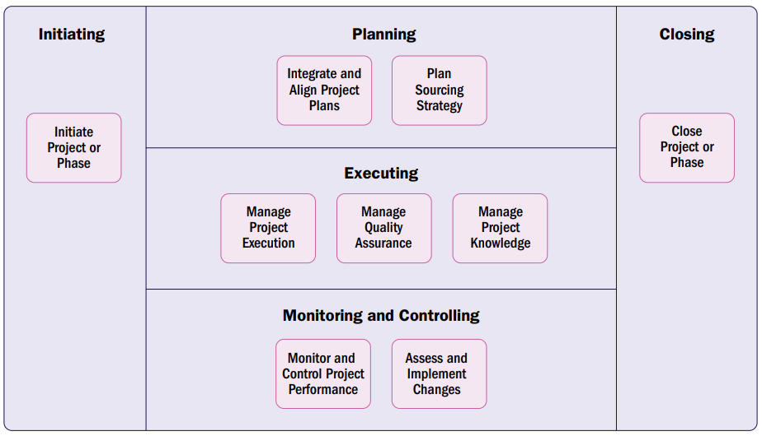

Slide 5
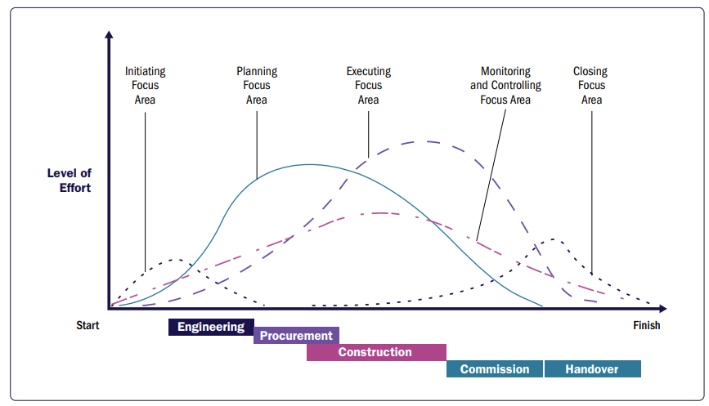

Slide 6
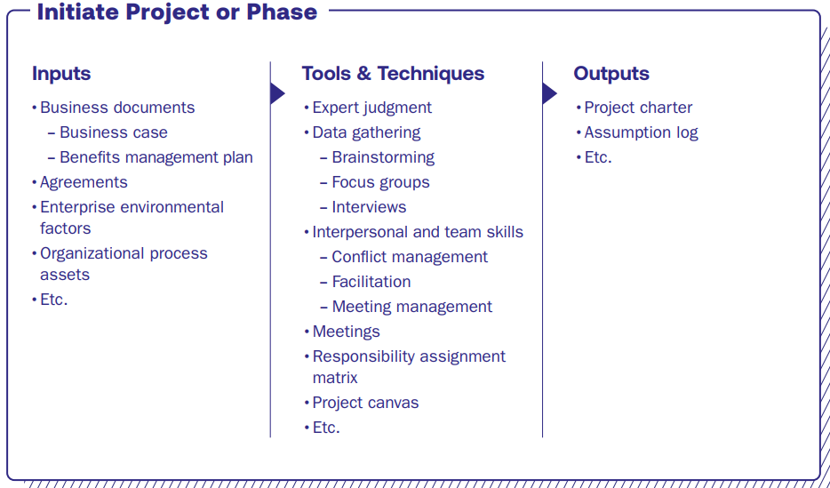
Initiate Project

Slide 7
Responsibility Assignment Matrix
 | Website manager | Web developer | Content administrator | Web administrator |  | Sales manager
Project planning | A | R | C | C |  | C
Website construction | A | R | C | C |  | I
Content review | I | C | A | R | I | I
Usability testing | I | A | C | R
Installation of tracking software | I | A |  | R
Ongoing review of visitors |  | A |  | R |  | A | R
Sales follow up to frequent users |  |  |  | I |  | I
R=Responsible, C=Consulted, A=Accountable, I=Informed.

Slide 8
Project Charter
Project Purpose/Justification
SMART Project Objectives
High-level requirements
Assumptions and Constraints
Project Boundaries
High level Risks
Summary budget & milestones
Initial Stakeholder List
Project Approval Requirements
Assigned Project Manager

Slide 9
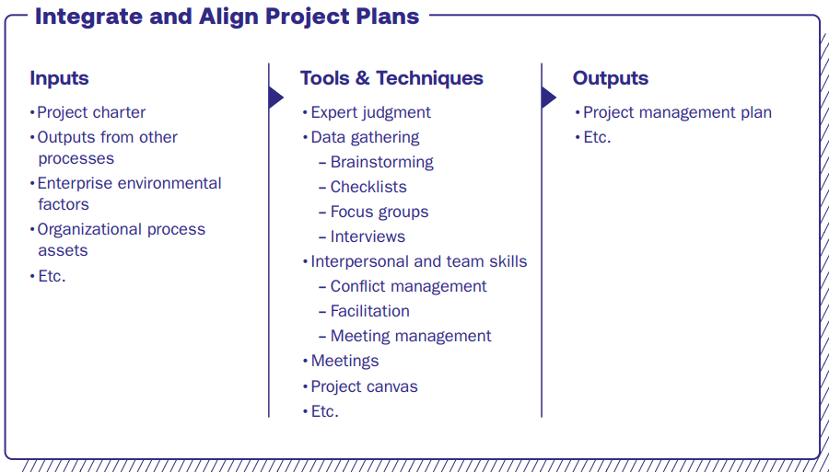
Integrate and Align Project Plans

Slide 10
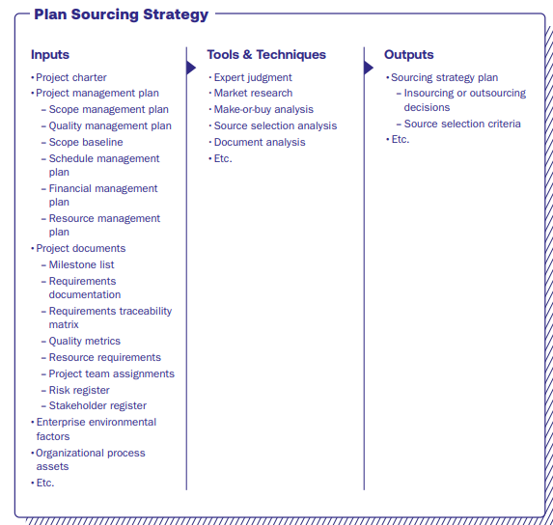

Slide 11
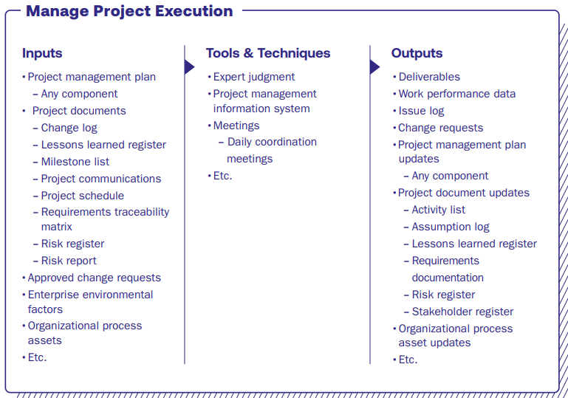
Manage Project Execution

Slide 12
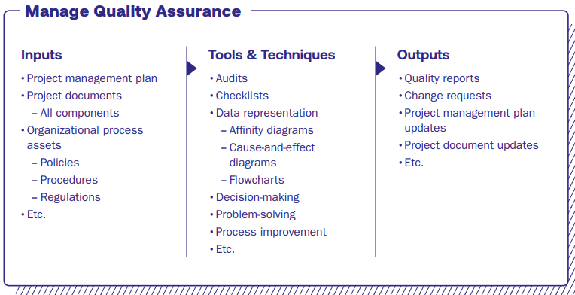

Slide 13
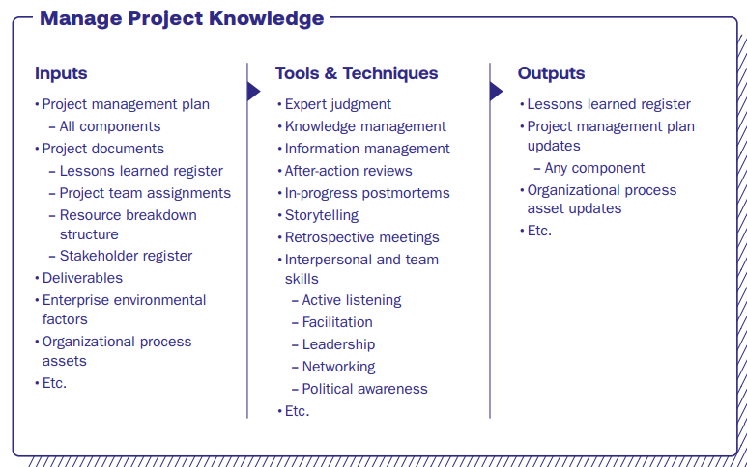

Slide 14
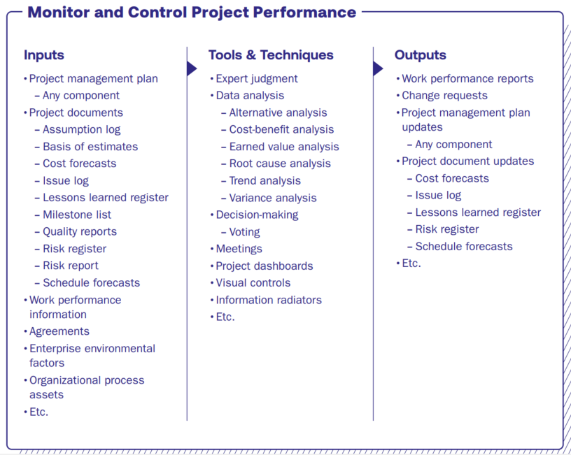

Slide 15
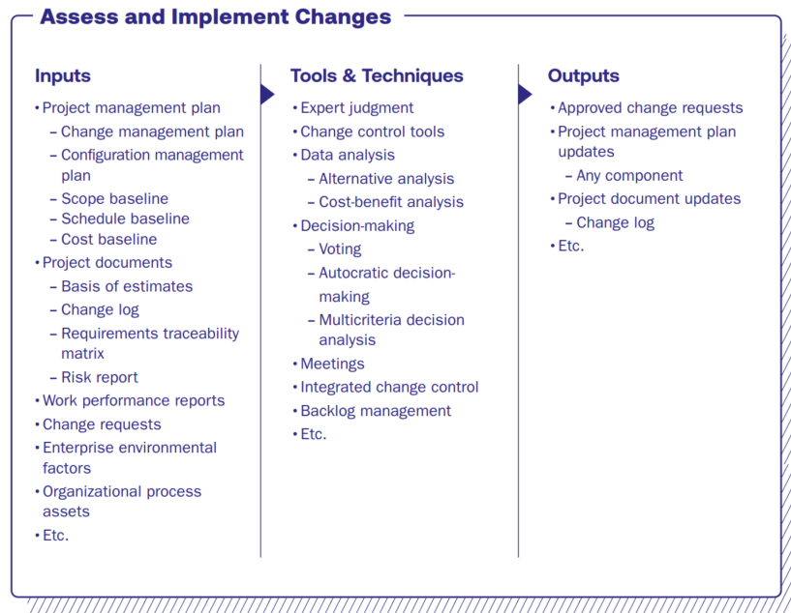

Slide 16
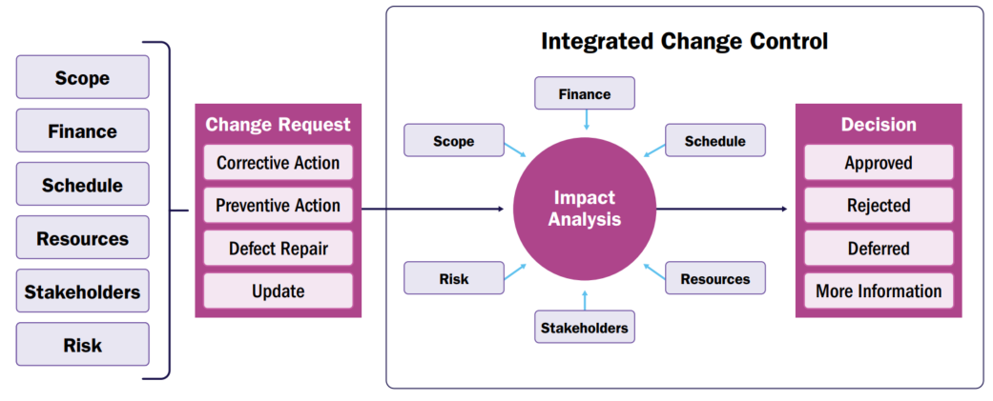

Slide 17
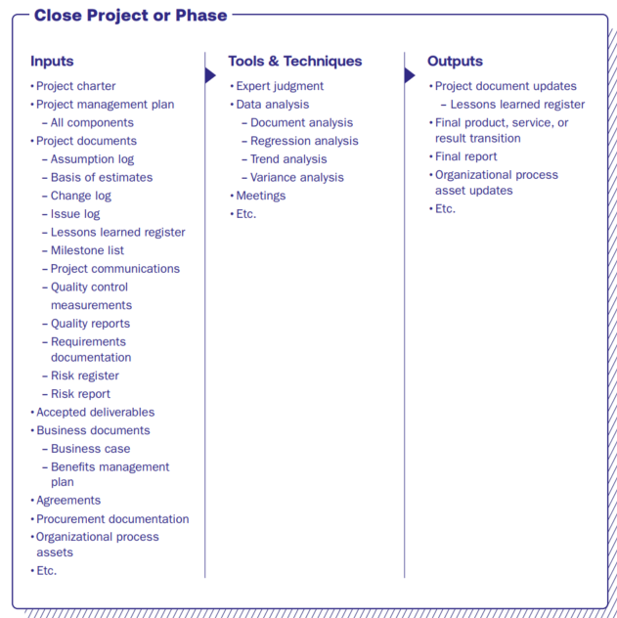

Slide 18
Thank You

